Slide 1
Week 4 Presentation
Group 1:
Alex Holmes Jibin Mathews

Slide 2
Objective
Learn Verilog and Vivado Interface
Make a DC motor that spins in both directions with variable speeds
Using BASYS FPGA Board
Utilize switches SW0-SW7
Maintain current flow using Shunt Resistors
Implement over-current protection
Notes:
Add references to images and Names to specific slides next to slide number

Slide 3
Deliverables
Vivado Downloaded
Attended Verilog Tutorials Held by Akhil
Setting up Vivado
Example PWM Code
Send code to board

Slide 4
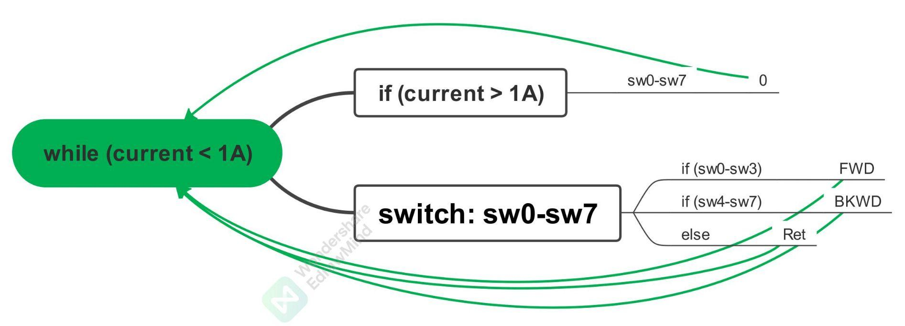
Flowchart

Slide 5
Budget
Budget Mini Project | Cost: | Total Spent:
H-Bridge Motor Driver | $23.53 | $0.00 |  | Material Costs | Cost: | Total Spent:
L298N | $6.50 | $0.00 |  |  | $286.06 | $0.00
Linear Voltage Regulator | $1.79 | $0.00
Optocouplers | $1.40 | $0.00 |  | Labor | Rate | Hours Spent
Resistors | $3.28 | $0.00 |  |  | $15.00 | 30
Diodes | $5.90 | $0.00
Capacitors | $2.12 | $0.00 |  | Totals | Total Cost: | Actual Cost:
Board | $0.40 | $0.00 |  |  | $421.06 | $450.00
Connectors | $2.14 | $0.00
BASYS FPGA Board | $149.00 | $0.00
Rover 5 Robot Chassis | $90 | $0.00

Slide 6
Next Week's Deliverables
Functioning Motor
Assembled Mini Project
Current Limiter
Basys, H Bridge, and Rover Motor Connected
Programmed Mini Project
Software Current Limiter
Switches
Input/Outputs

Slide 7
Gantt Chart
Mini Project | Week 1 | Week 2 | Week 3 | Week 4 | Week 5
Hardware
H-Bridge
Basys Board w/ Motor
Full Assembly
Software
Research
Download/ Install Vivado
Actual Coding

Slide 8
Questions
?

